Slide 2
Notes:
Play video at https://bankingonmycareer.com/success-in-fs
Talk about what this video is communicating about the expectations, culture and pace of the industry. Talk with your audience about what stood out to them and how the video changed some of their thinking about the industry.
This video was designed to give students and job seekers a window into the industry. It is a concept focused on the idea that our actions have rewards and consequences. We want to encourage our audience to think about moments when they have made uninformed decisions that didn't turn out the way they wanted. We are introducing the idea that with the right information you can make good decisions that lead to the kind of career that you want. We will simultaneously introduce:
BankingOnMyCareer.com
The project partners and their types
The features and functionality of the site
The industry must know messages/Litmus Test
The primary target audience – Career Starters
A concept that can continue beyond the site and can be shared and discussed
Fun

Slide 3
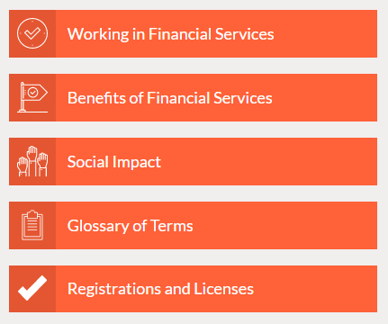
Notes:
Many people don’t yet know that Financial Services covers a wide range of careers. From the Tellers and Customer Service Representatives who help you open a new checking account, to the people behind the scenes who make your financial transactions go through smoothly, like the Operations Assistant. Financial Services encompasses a diverse set of exciting career opportunities.
This site helps people understand the industry more fully, In addition, it can help job seekers and students understand where they fit in the industry.
When people visit the site, they can go to the section called About Financial Services. In addition to an industry overview, they can learn about Working in the Industry and what it takes to build a successful career there. They can also read about the benefits of Financial Services. Users can learn about how the industry is a place that fosters diversity, helps people grow their careers, and is truly a community of great people. In the Social Impact section, people can learn how the industry benefits NYC. They can also find a Glossary of industry terms and information about registrations and licenses common in Financial Services.

Slide 4
Want to work help people everyday?
Do you have an eye for detail?
Are you good with numbers?
Notes:
It’s not easy to know what you want to do for a living when you can’t possibly know all the jobs out there. However, there are tools to help you begin to think about what you’ll enjoy doing as opposed to ending up in a job you don’t like.
What if there was an online tool where you could indicate how much you love or dislike doing something and what you’re good at and it would tell you what jobs might be a good fit for you?
BankingOnMyCareer.com can help you figure out what your dream jobs is. It’s just a starting place for you to begin the exploration that will lead to a job- and a career, you love.

Slide 5
Notes:
The Match Me Tool asks you to indicate how interested you are in things like, managing people and working with data.
Next, it asks you what skills you have- things like working with numbers, good communication, and understanding process improvement.
Last, it asks what level of education you want or currently have. Are you hoping to get to work in the next year or so or are you thinking about a 2 year degree?
While we’re on the subject, I want to let you know that a lot of the jobs on this site pay over $25/hour and don’t require a bachelor’s degree. If you’re thinking that 4 years is too long, and frankly too expensive, this may be the right place for you!

Slide 6
Job Descriptions
Read relatable, real life descriptions of day-to-day life in popular jobs
See the potential salary range
Find out what education you need to get the job
See how your interests, skills, and education match up with each job
Notes:
What does is really mean to be an analyst? What would you actually do all day if you were an Operations Assistant? Unless you are lucky enough to know someone currently working in these types of jobs, it’s hard to figure out what you would be doing. Even harder to know if you’ll enjoy it.
The job descriptions at BankingOnMyCareer.com can help you do just that. These descriptions aren’t full of jargon, instead you’ll find that they tell you specifically what you would do in this role. These descriptions even tell you where your skills and interests match up to those in the job.

Slide 7
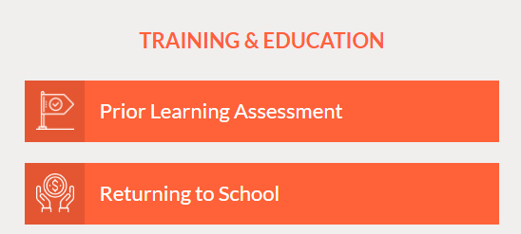
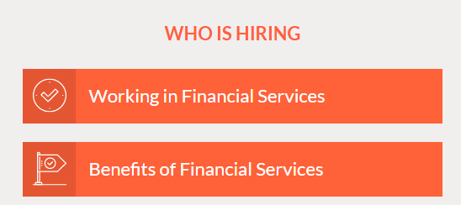
Education and Employers
School Profiles
Connections to Programs
Links to Scholarships
Company Profiles
Links to Job Listings
Social Impact
Notes:
Education (Training & Education):
If you’re considering more education, or even if you’re not, check out this site. There is a lot of information on schools and high quality, affordable (really!) education near you. A well-paying, secure job in Financial Services may only be 9 months away with the right certificate program at your local community college.
Employers (Who is Hiring):
You’ve waked by bank branches and insurance offices many times, but have you ever thought about what it’s like to work for these companies? These are great organizations that really care about their employees. They want their people to have long-term, fulfilling careers and provide benefits to help make that a reality. You can provide for a family and have a job you love at the same time. Visit the site for information on what it’s like to go to work for Financial Services companies.

Slide 8
Notes:
Get your career right the first time by learning about different jobs, what it’s really like to work in an industry and more at BankingOnMyCareer.com

